Slide 1
This is a hidden slide
Dear honorable teacher please follow the instructions that has given in the slide notes. (under the every slide). It would be helpful to take a successful class. Thanks a lot. I wish you good luck.

Slide 2

WELCOME
Notes:
Teacher can say it orally.

Slide 3
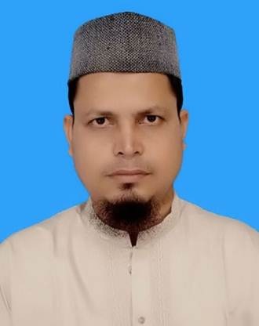

Identity
SK. Md. Harunar Rashid
B.A(Hon’s)M.A.B.Ed.
Senior Assit: Teacher.
Sonatola Model High School, Sonatola, Bogra.
English For Today
Class : Six.
Notes:
Teacher can hide this slide.

Slide 4
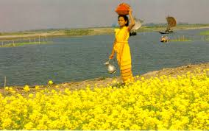
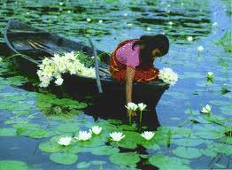
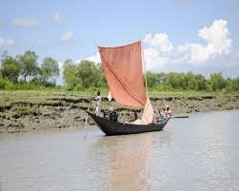
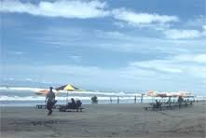
LOOK AT THE PICTURES
Do you know what about these pictures ?
These are beauties of Bangladesh.
Notes:
Showing the picture teacher can ask the question to the whole class. SS will raise their hands. Teacher can ask 5/6 students to narrate the picture.

Slide 5
Today`s topic
An unseen beauty of Bangladesh
Lesson : 13,

Slide 6
Learning outcomes
After completing the lesson students will be
able to –
# ask and answer the questions
# read and understand text
# write short paragraphs
# Describe the beauty of Bangladesh.

Slide 7
Let’s watch a video clip
Beauty of Bangladesh.
Now discuss with your partner about the video and write three sentences on it.
Notes:
Showing the video teacher can ask the question to the whole class. SS will raise their hands. Teacher can ask 5/6 students to narrate the video.

Slide 8
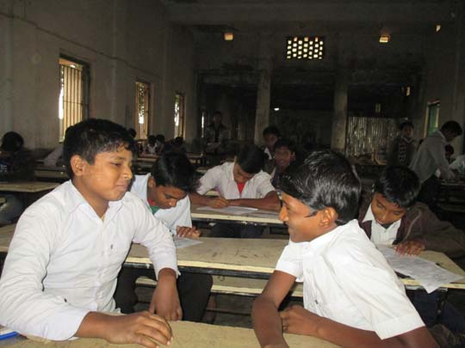
Go to section A and Follow the conversation then practice in pairs.
In the last winter vacation I went to Cox’s Bazar with my family. I enjoyed many things like watching sun rise and sun set, bathing on the beach, watching the natural beauty of St. Martin’s etc.
Have you ever visited any interesting tourist spot in Bangladesh ? If you have, what was that place. What special attractions did you see there ?
Notes:
Showing the conversation teacher can call pair by pair to practice it.

Slide 9

IQ - TEST
EYE - CORNER
Dear students, can you say me a beautiful district’s name of Bangladesh according to above picture ?
NETROKONA
Notes:
A game can be played for making classroom environment for the lesson. The teacher can arrange another puzzle if he/she wants.

Slide 10
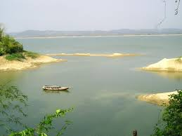

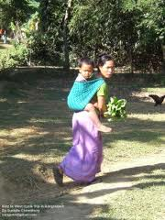
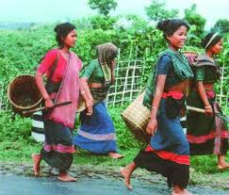
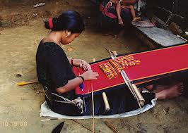
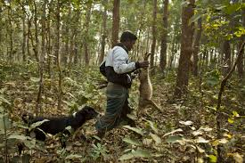
The main attraction of Durgapur in NETROKONA.
The Someshwari river.
Ceramic mountain-blue water.
There are many Ethnic groups in Netrokona.
Notes:
After shown the picture T. can ask to SS for narrate the picture, then he/she can give feedback.

Slide 11
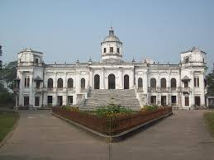

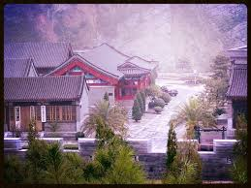
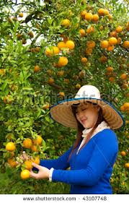
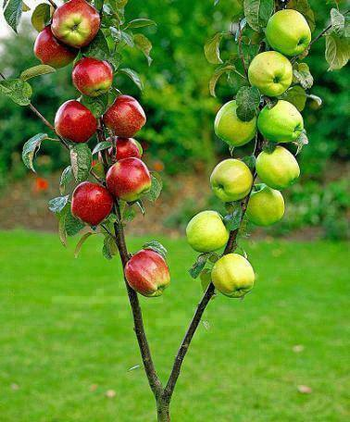

Place
Dasha Bhuja Temple
RamKrishna Temple
Orange Garden
Apple Tree
Locknathbaba Temple
Notes:
After shown the picture T. can ask to SS for narrate the picture, then he/she can give feedback.

Slide 12
Read the text and complete the dialogue then act it out in pairs.
A : Are there any rivers in Birishiri?
B : Yes, there are. There are two rivers, the Shomeshwari and Kangsa.
A : ls there any hills in Biriishisi?
B : Yes……………. is. lt's called …………………
A : Can I see any other hills from there?
B : Yes, you ……………. You can see the hills of …………… state from here.
A : Will I see people of various ethnic groups there?
B :Yes, you………...You will see people of Hajong, Achik and tribes.
A : Are there any temples there?
B : Yes. there .You can see the Dasha Busha Temple and the …………. temples there.
Notes:
After listening from teacher SS will go to section B1 then solve the problems.

Slide 13
VOCABULARY : SYNONYMS AND ANTONYM
Main words | Synonyms | Antonym
Quiet | Calm | Noisy
Unlimited | Vast | Limited
Eye-catching | Attractive | Dislike
Amazing | Uncommon | Common
Crystal clear | Transparent | Dirty
Vibrant | Charming | Disgusting
Unfolded | Discovered | Folded
Best | Fine | worst
Notes:
Teacher will discuss all new words with their meaning, synonyms and antonyms. First he/she throw the word to elicit the answer.

Slide 14

Eye-catching destinations
phrase
Bangladesh is the true home of eye-catching natural beauty.
Meaning
(Click here)
Places that draws one’s attentions.
Notes:
First, the phrase can be shown. The SS can be asked to pronounce the phrase. If it is needed teacher can help. Then the picture can be shown and asked to guess the meaning. For feedback click on meaning button.

Slide 15
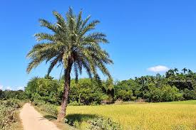
Green, remote countryside
phrase
How beautiful our green, remote countryside is !
Meaning
(Click here)
A rural and distant place full of plants and trees.
Notes:
First, the phrase can be shown. The SS can be asked to pronounce the phrase. If it is needed teacher can help. Then the picture can be shown and asked to guess the meaning. For feedback click on meaning button.

Slide 16
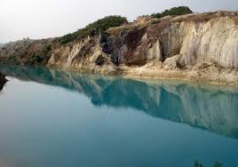
Crystal clear
phrase
The water of Someshwari river is crystal clear.
Meaning
(Click here)
See-through.
Notes:
First, the phrase can be shown. The SS can be asked to pronounce the phrase. If it is needed teacher can help. Then the picture can be shown and asked to guess the meaning. For feedback click on meaning button.

Slide 17
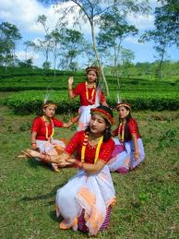
Vibrant tribal culture
phrase
Durgapur is also rich in vibrant tribal culture.
Meaning
(Click here)
Lively activities of tribal groups.
Notes:
First, the phrase can be shown. The SS can be asked to pronounce the phrase. If it is needed teacher can help. Then the picture can be shown and asked to guess the meaning. For feedback click on meaning button.

Slide 18
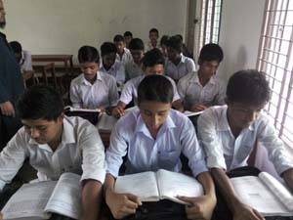
Pair works
Read the passage attentively , go to the section B2 then discuss the following questions in pairs.
Notes:
Teacher can evaluate it by orally or written from the SS.

Slide 19
Individual/Pair Works - B
Fill in the blanks with your own words.
unlimited
The beauty of Bangladesh is (a) ------------- . Very few of them (b) ------- known to us. One of such (c) ---------- places is Shusong Durgapur. Shusong Durgapur is an (d) --------------- place. The river (e) ---------------flows beside it and the (f) ------------ is close to it. It has a (g) ------------- mountain-valley whose blue water reflect the (h) ---------- sky. It is in (i) --------------- District and can be a (j) ---------- tourist spot.
are
Less-known
amazing
Someshwari
Garo hill
pictorial
blue
Netrokona
famous
Notes:
First the task will be given, teacher can make it easy if needed, after a few minutes teacher will give feedback by click one by one.

Slide 20

HOME WORK
Write five sentences about the beauty of your own district.

Slide 21
Acknowledgement
We would like to express our cordial gratitude to the Ministry of Education, Directorate of Secondary & Higher Education, NCTB, a2i
and
the panel of honorable editors ( Md. Jahangir Hasan, Associate Professor (English) TTC, Rangpur, Ranjit Poddar, Associate Professor (English) TTC, Dhaka, and Urmila Ahmed, Associate Professor (English) TTC, Dhaka, to enrich the contents.

Slide 22
THE END

